Slide 1
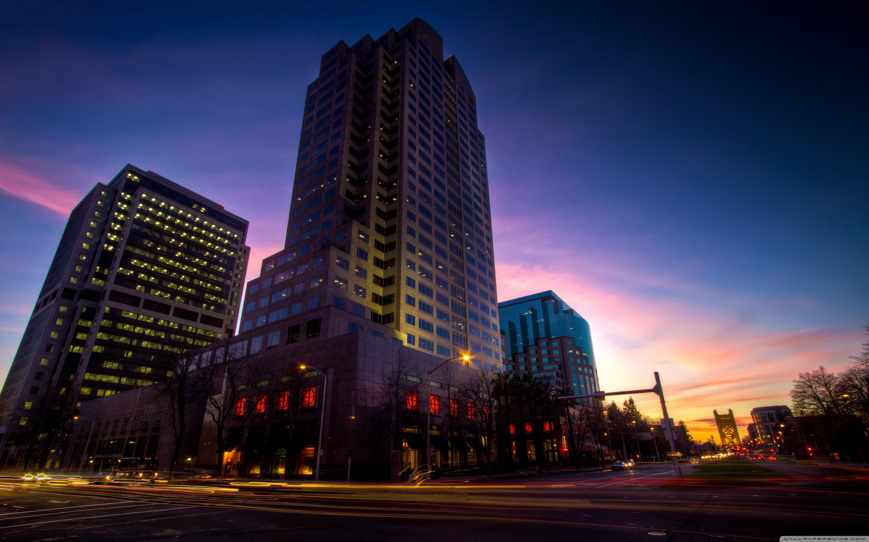
Social Sac SacHacks 2021
Drew Gipson
Nathan Barnes
Abdullah Lababidi
Notes:
Welcome to the presentation! My name is x and I will be walking you through

Slide 2

Agenda
Houselessness
Statistics
Solution - Social Sac
How it works
Opportunity
Organizations
Team
References
Notes:
Let’s take a quick a look at the Agenda. We’ll start of with description of the houselessness and showing some statistics, then presenting Social Sac and how to use it, next showcasing the opportunities available for using such a service to reach a wider audience by working with other non-profit organizations.
And then let’s meet the team!

Slide 3
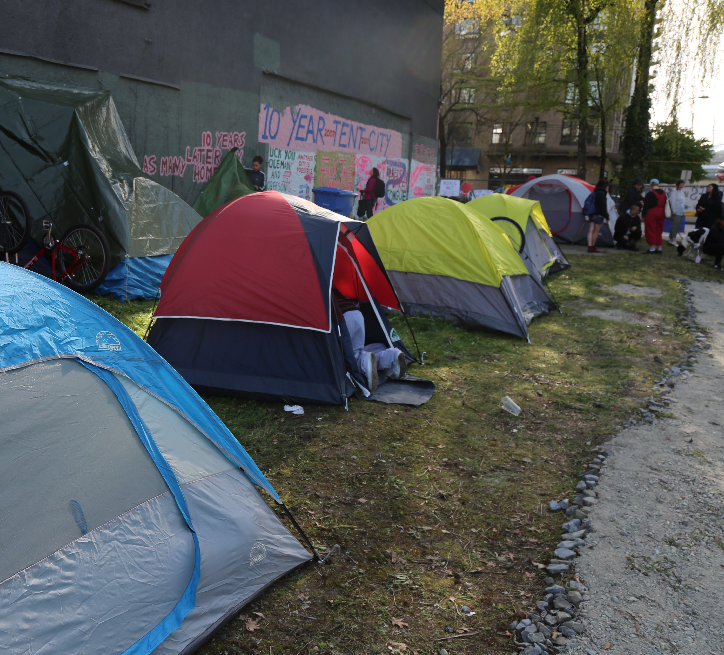
Houselessness
Houselessness is more visible than ever in downtown Sacramento
People without housing are high consumers of public resources and generate expense, rather than income, for the community
They are vulnerable and lack the safety that a home provides.
Notes:
Stress and trauma of living without a home that leads to addiction and disease or makes it worse.
Many think that substance abuse and mental illness is a cause of houselessness, whereas it’s more of a result of houselessness.

Slide 4
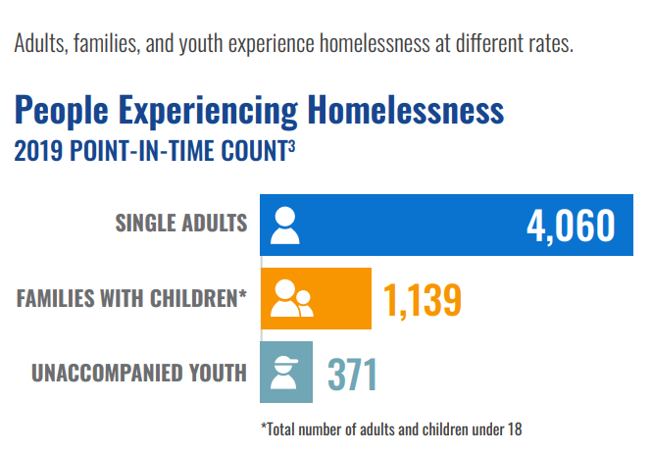
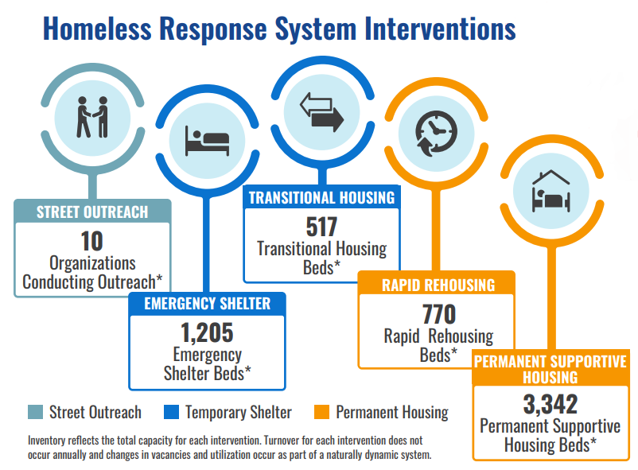
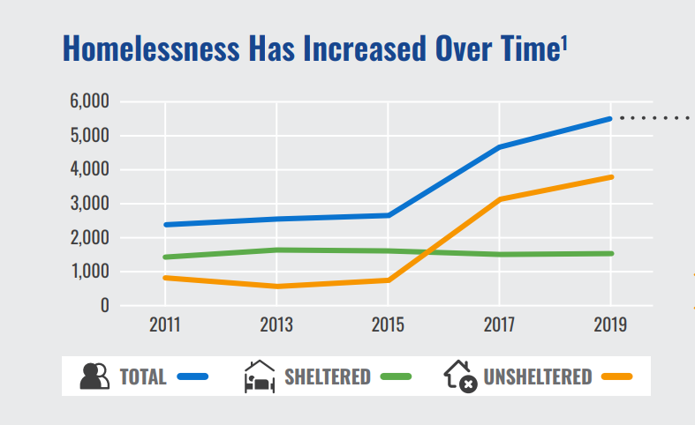
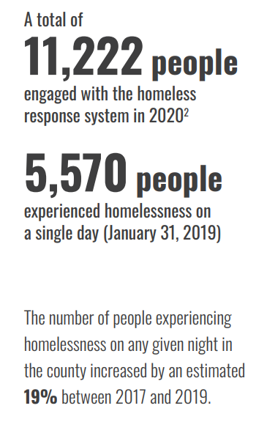
Statistics
Notes:
The following stats are from sacramentostepsforward.org showing that more that 5000 individuals were houseless at one point of time.
We also notice that number increases year by year, and if not address, will create a much more economic impact that it already is.

Slide 5
Houselessness Statistics
During 2020, 11,222 people were engaged with the houseless response system
6,111 of those were new to, or re-engaged with, the system
They joined 5,111 people already experiencing homelessness at the start of the year
2,761 people achieved permanent housing
4,418 people remained connected to the system
4,043 people disengaged from the system
Notes:
In 2020, the total number of Permanent Supportive Housing beds available for new placements was less than the overall capacity because many of those units were already being utilized.

Slide 6
Social Sac
Social Sac provides a dashboard that aggregates data concerning weather forecasts and alerts, warm shelter availability and helpful info, COVID-19 vaccine information, and foodbanks/community refrigerators.
On the back end, the tool uses custom web scraping helpers and scheduled tasks to obtain the most up-to-date info on shelter availability and weather, and maintains a SQL database of the associated info.
Notes:
We present you Social Sac! …….(need to add)

Slide 7
DEMO
Notes:
(need to add)

Slide 8
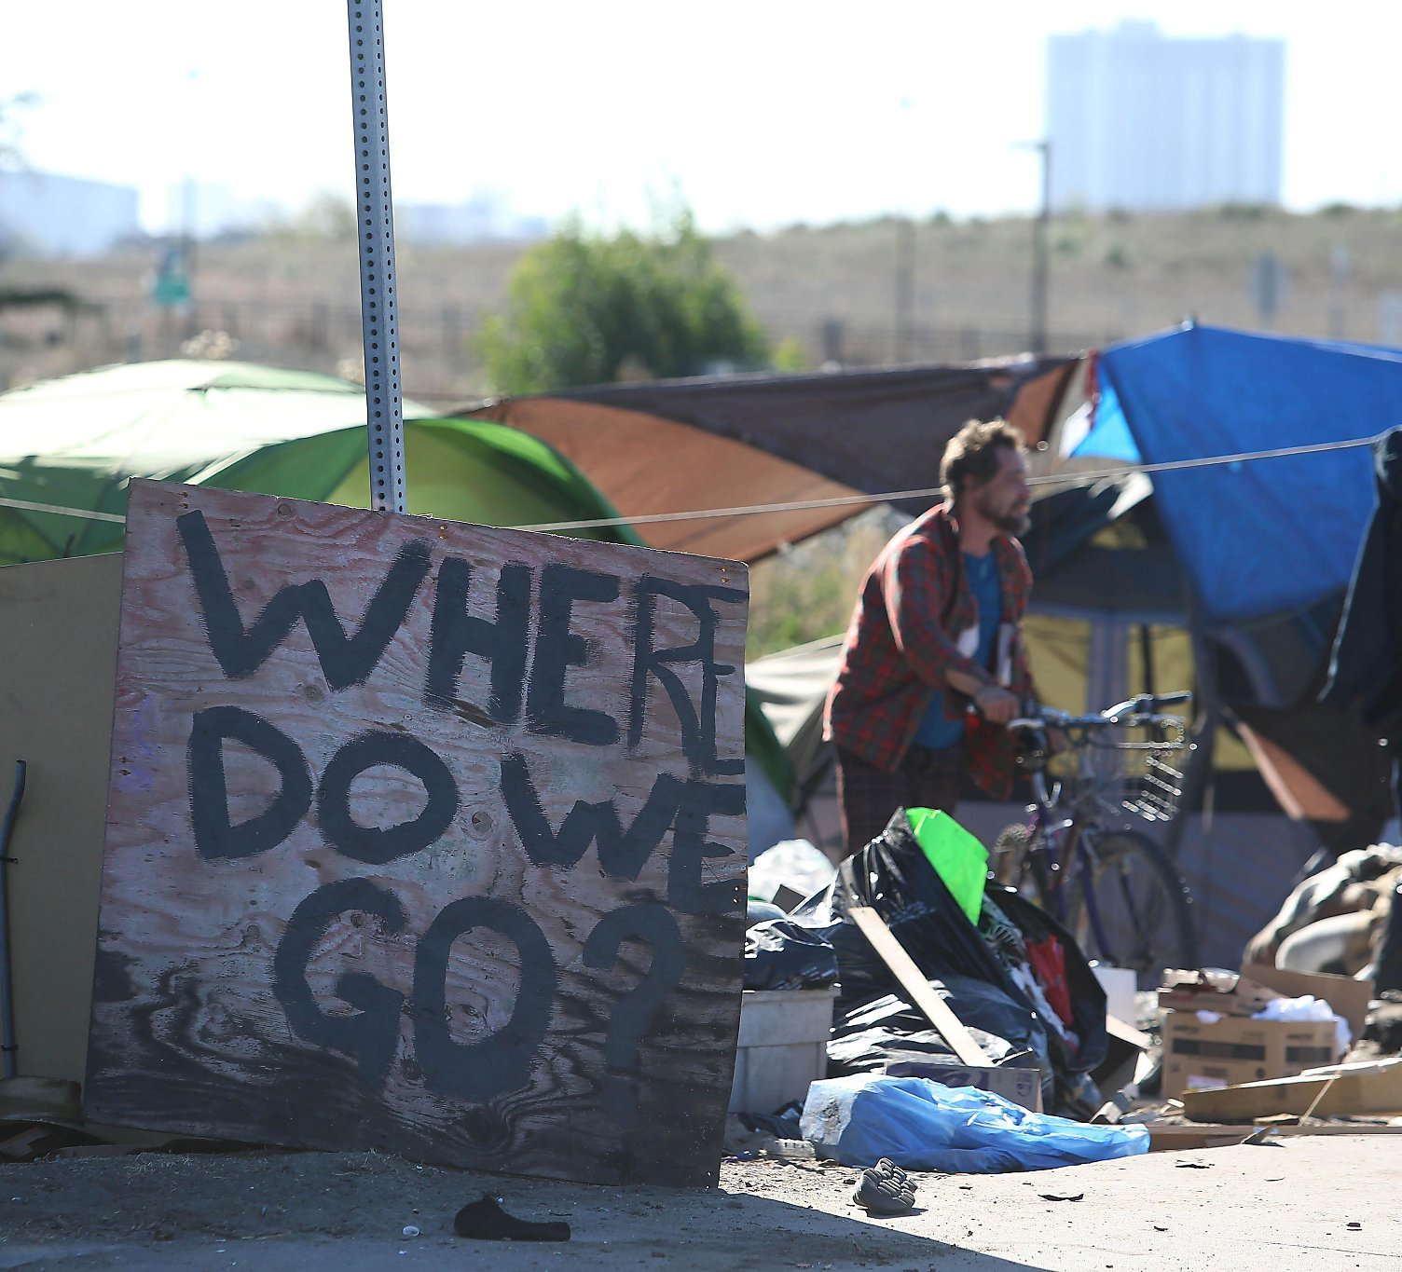
Impact
Connecting those in need with organizations providing help and a home.
Support the community
Cleaner cities and streets
Healthier individuals
Making a difference
Social Activism
Notes:
Houselessness is a complex issue for which there is no single cause or solution, and it is not an inherent fault of the individual. In Sacramento, similar to other communities, there are systemic factors contributing to homelessness. Connecting those in need with organizations providing help and a home. Our own community members live in tents and under bridges, vulnerable to inclement weather and violence, stripped of dignity and our collective respect. Let’s aim to support the community, create a healthier community, and make a difference!

Slide 9
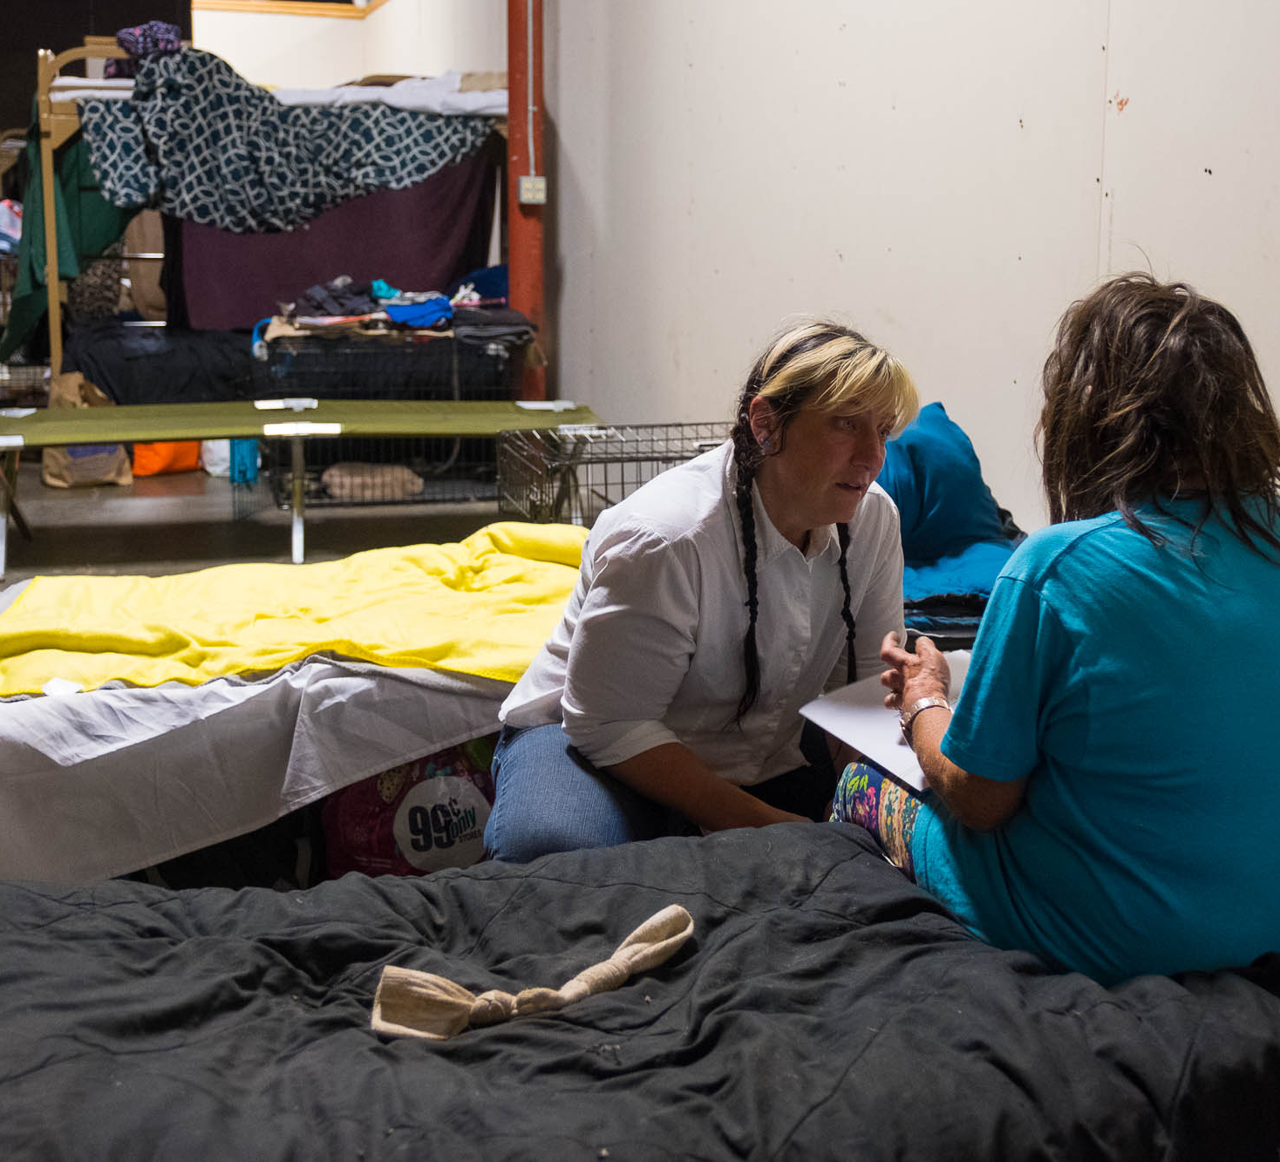
Opportunity
Feed the hungry
Physical Health
Mental Health
Job opportunities
Access to Education
Notes:
There is some great room for improvement in this crisis; houselessness impacts all of us, whether or not we experience it ourselves. The goal is providing supportive services that include feeding the hungry, treating the sick, and providing access to education and jobs.

Slide 10
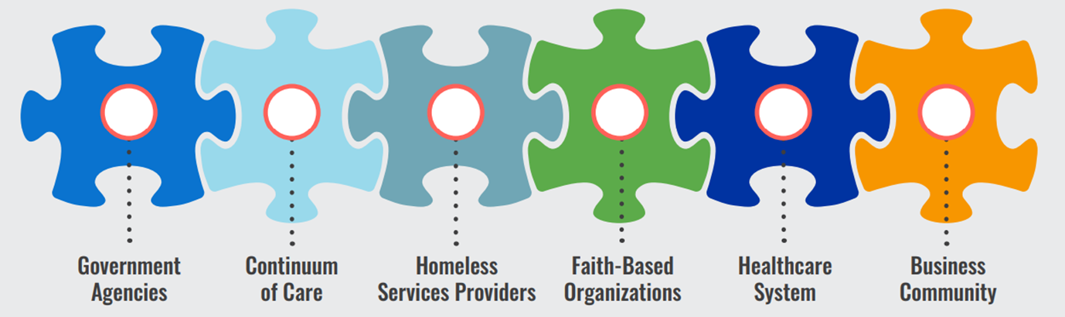








Organizations
Notes:
There are some great organizations out there that would be great partners for our initiative to reach more people in need, and to provide support

Slide 11
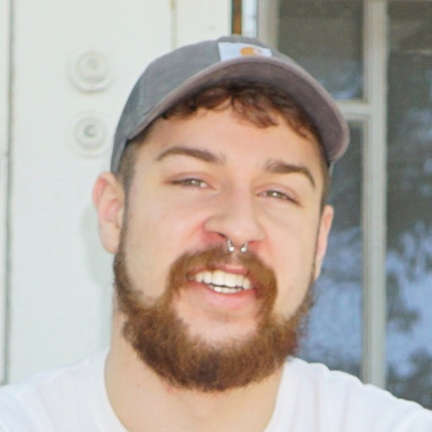
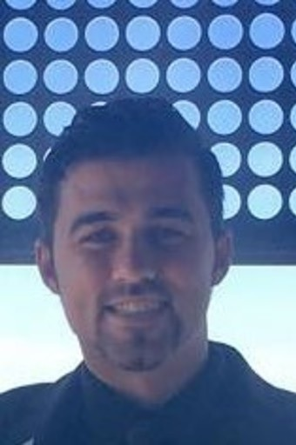

Meet the Team
Backend / frontend
Web dev
Design
Drew Gipson
Nathan Barnes
Abdullah Lababidi
Cybersecurity specialist
Security+
ECE Engineer
Notes:
Meet the team! Drew is an accomplished Cybersecurity Specialist and a Teacher Assistant for the Cyber UC Davis Bootcamp. He came up with the idea for the project and worked on both the backend and frontend of the code. Nathan is a recent graduate of the UC Davis Cybersecurity Bootcamp, with certifications from CompTia Security+ and Splunk. Abdullah is an Electronics and Computer Engineer with a passion for Project Management and Design. Together we were able to beat the pressure and come up with an innovative solution to reconnect the homeless with the Sac community.

Slide 12

References
https://sacramentostepsforward.org/wp-content/uploads/2021/02/Homelessness-In-Sacramento.pdf
https://www.capradio.org/articles/2018/06/28/lessons-learned-at-sacramentos-new-homeless-triage-shelter/
https://www.homewardboundwnc.org/wp-content/uploads/2013/02/Homelessness-Dec.-2012.pdf
https://www.saccounty.net/Homelessness/Documents/Infographic%20Final_Chronic%20Updated.pdf
Notes:
References are shown regarding some of the statistics shown in this presentation

Slide 13

Notes:
Questions?

